Slide 1
Project Module Overview and Data Flow
D: Stripe online payment
A: Customer Mobile App
E: Meteor Server-A
B: Calphin Admin PC
G: Mango DB
F: Meteor Server-B&C
C: Calphin Coach PC/Tablet

Slide 2
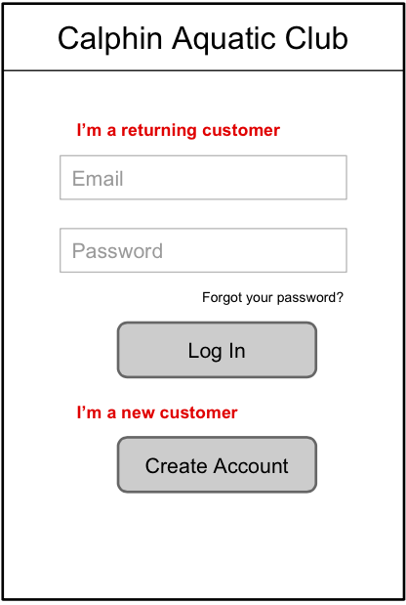
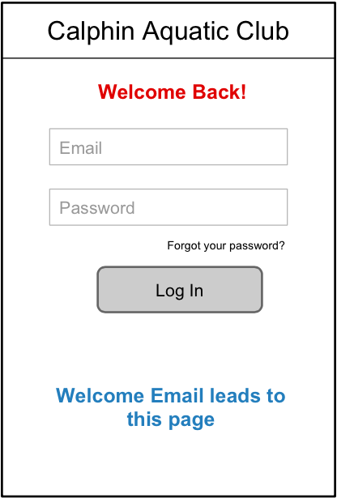
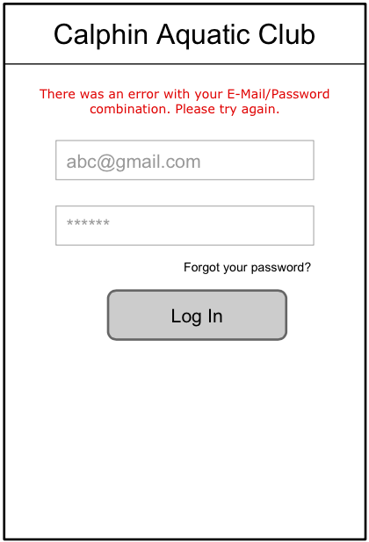
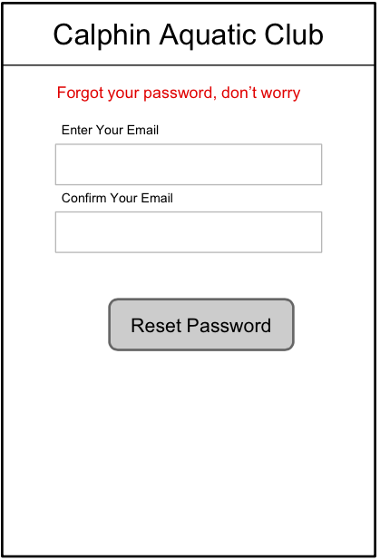
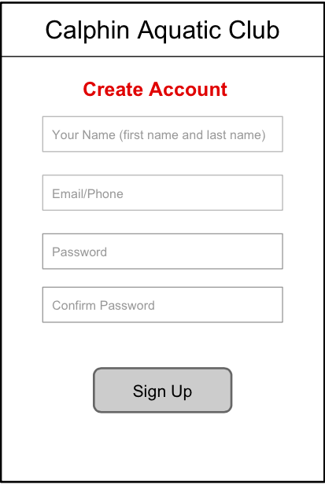
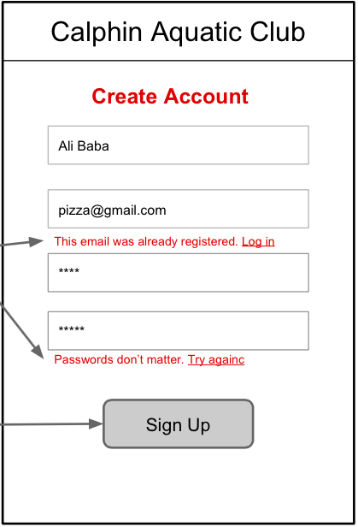
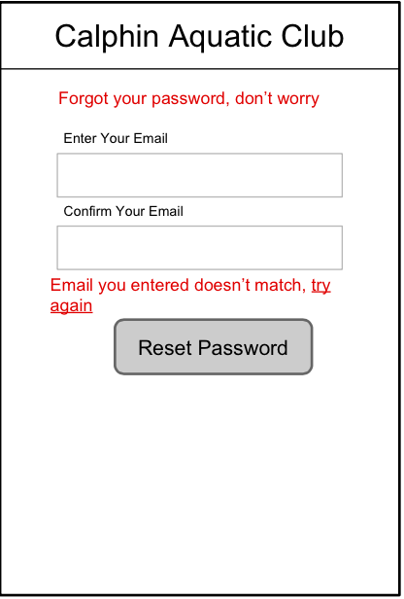
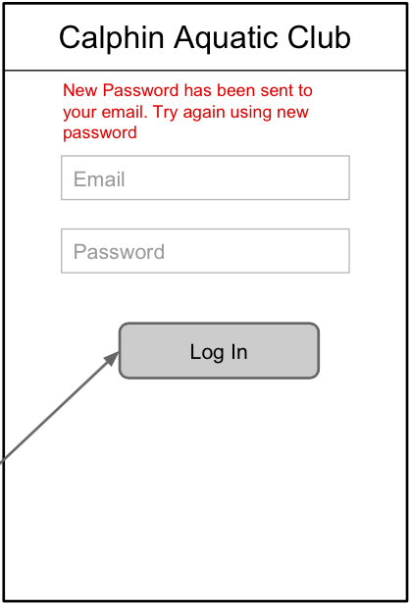
Log In
0.0a
0.0b
Homepage
1
1
1
Login
1
3
2
3
2
4
0.1
0.2
0.4
0.4
1
Sign-up
Sign-up
Login
Login
1
2
0.21
0.22
Pw-reset
Login

Slide 3
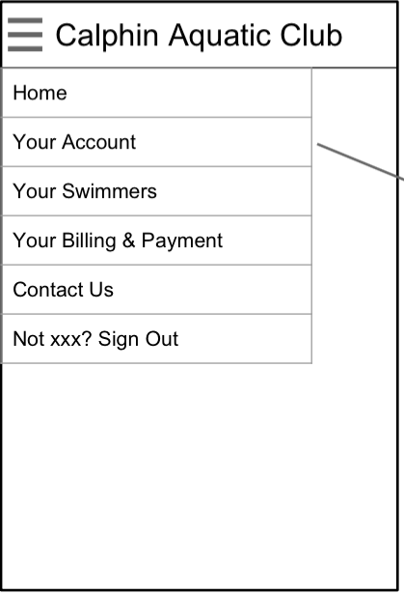
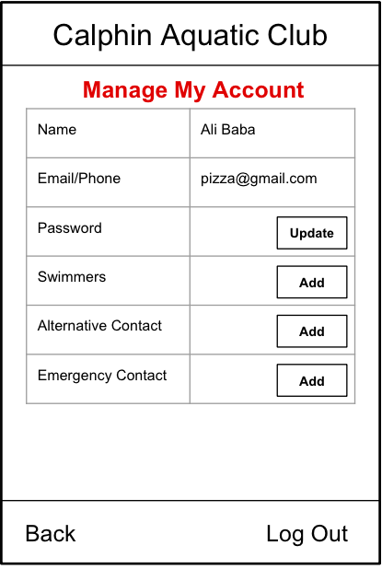
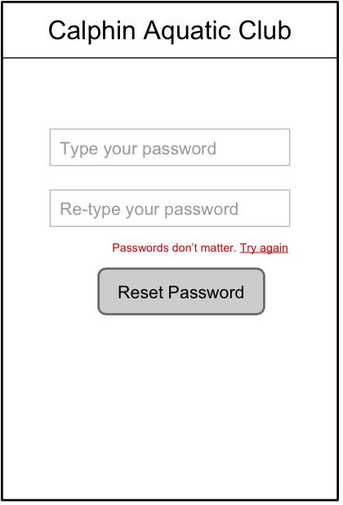
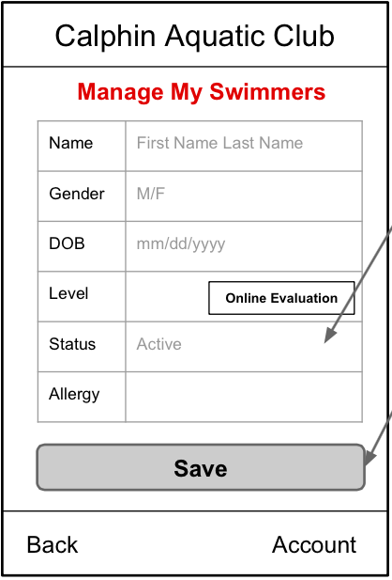
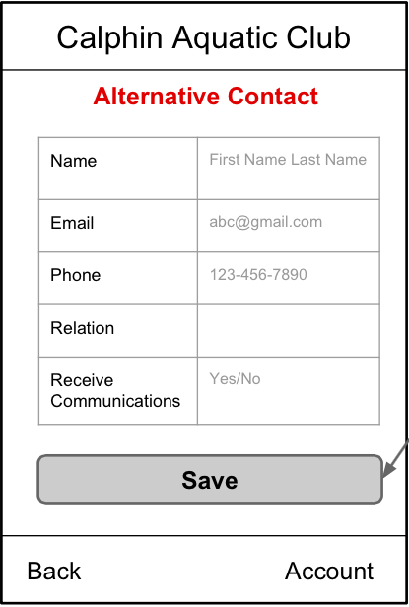
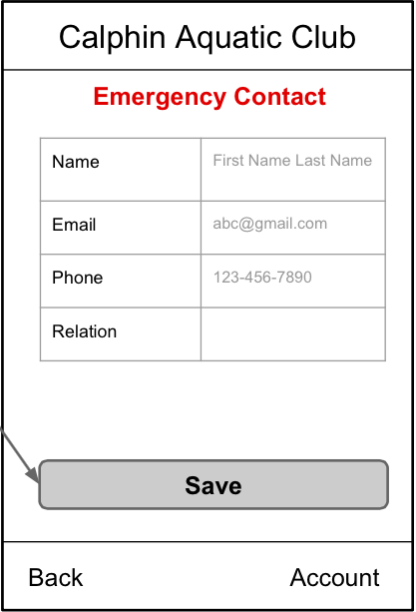
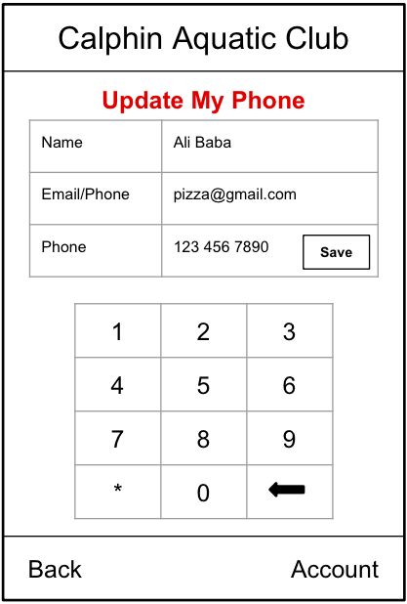
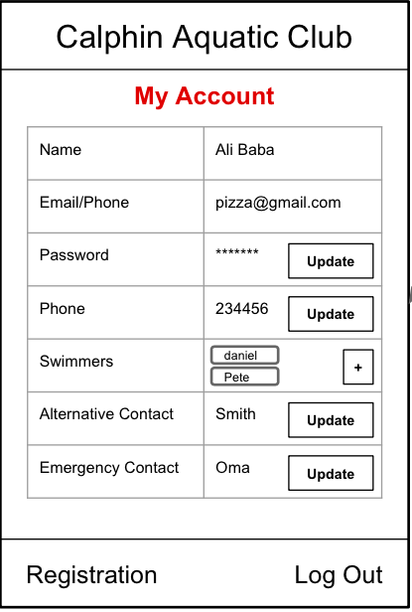
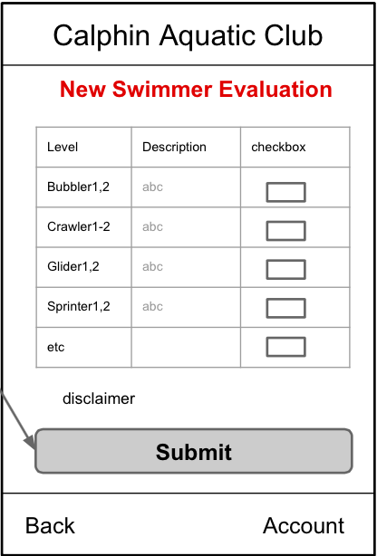
Customer Account -1
1.0
0.4
1
2
Nav-youraccount
Sign-up
3
4
1.1
Youraccount_accountID
1
Swimmerinfo_new/swimmerinfo_studentID
2
1.11
1.12
1.13
1.14
1.15
3
4
5
a
Pw-reset
1.11a
Phone#_accountID
1.12a
Alternatecontact_accountID
Emergencycontact_accountID
Youraccount_accountID
New-evaluation_studentID

Slide 4
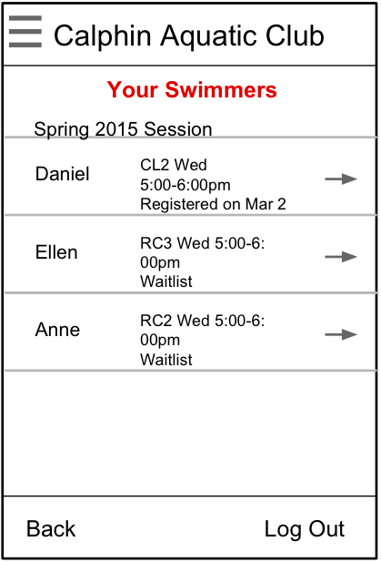
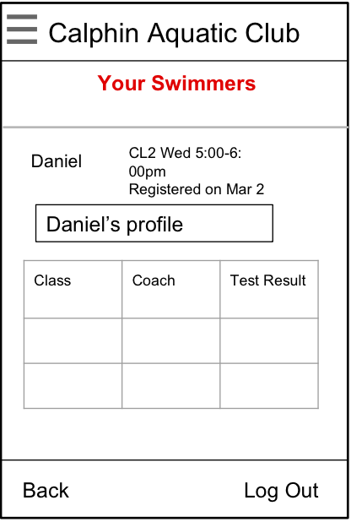
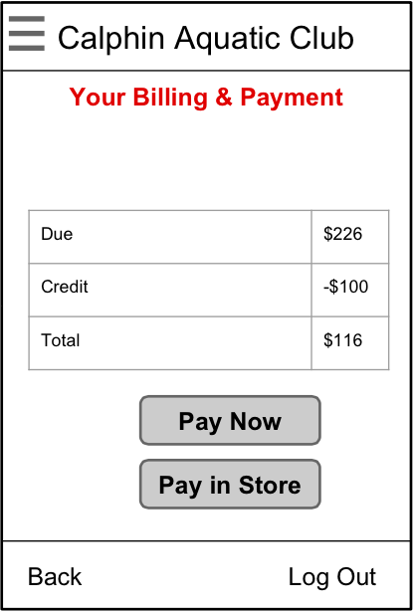
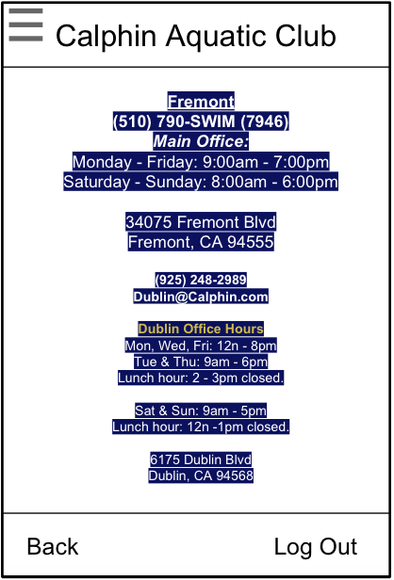
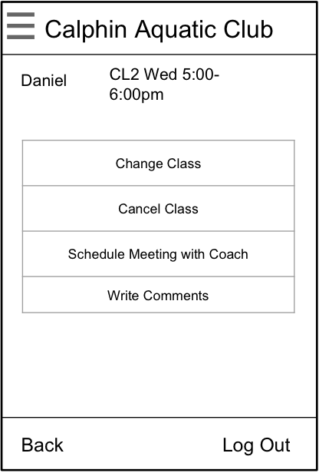
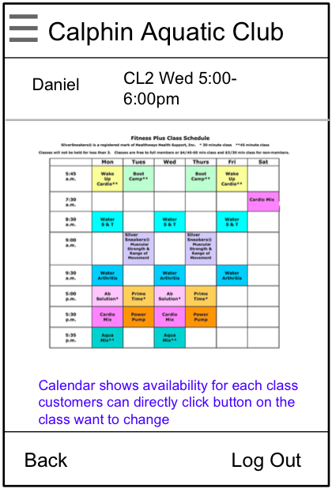
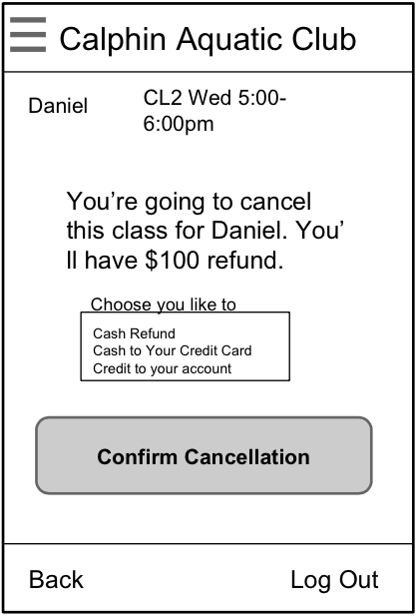
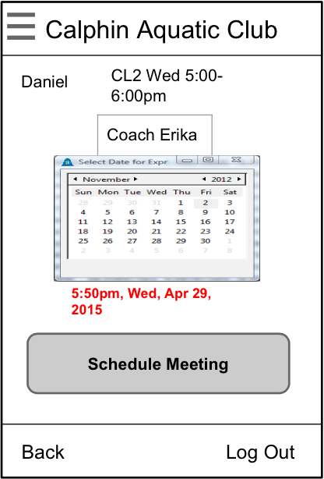
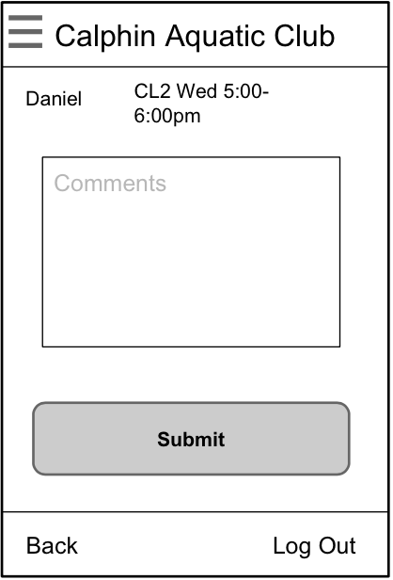
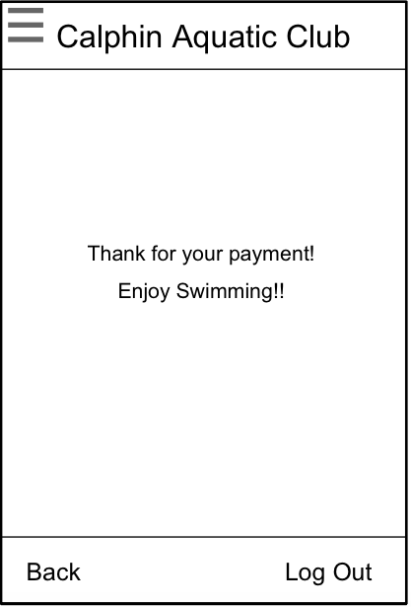
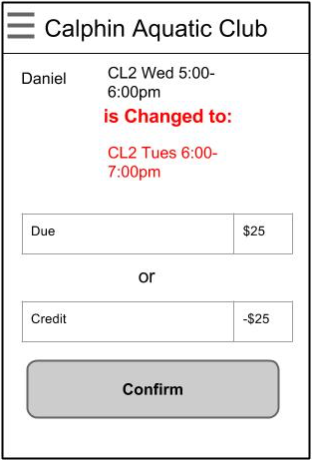
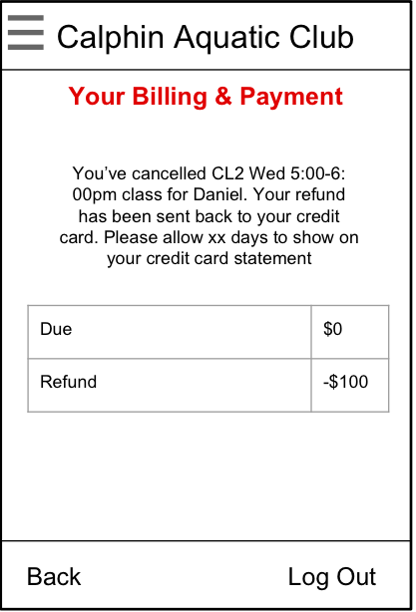
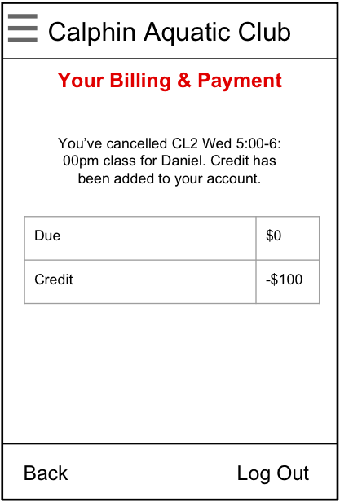
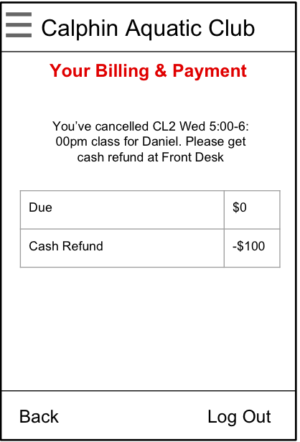
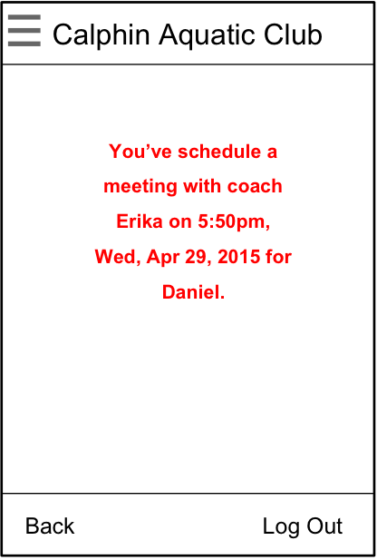
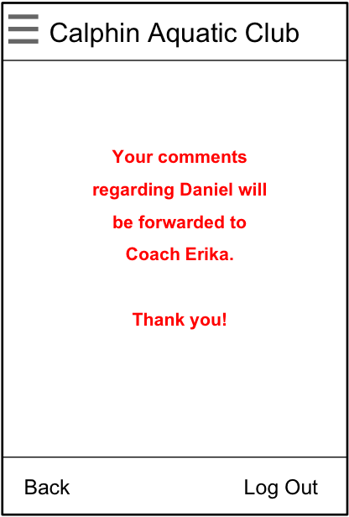
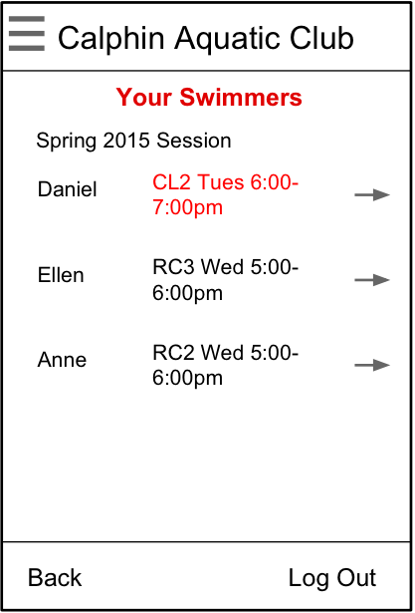
Customer Account 2
1.0
1.2
1.22
1
3
2
2
1
4
Classhistory_studentID
Nav-youraccount
swimmerlist
Billing
contactinfoc
Schedule-meetc
comments
1.3
1.4
1.21
1.21a
1.21b
1.21c
1.21d
a
c
b
1
1
d
1
1
1
Currentclass_stuentID
Changeclass_studentID_classID
Cancelclass_studentID_classID
1.31
1.21a1
1.21b1
1.21b1
1.21b1
1.21c1
1.21d1
Payment-confirm
Changeclass-billing_studientID
Cancelclass-billingconfirm_stuentID
1
1.21a11
meeting-confirm
comment-confirm

Slide 5
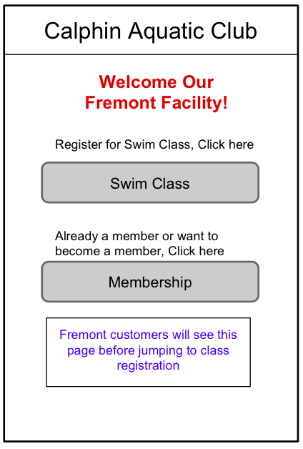
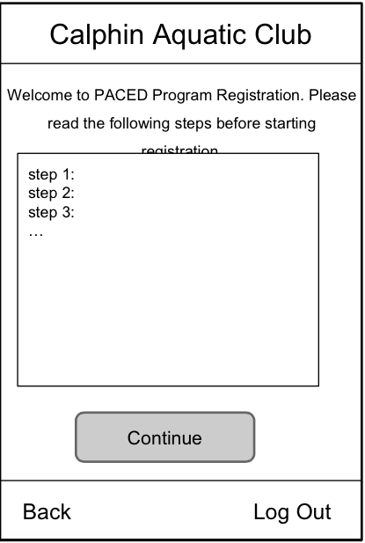
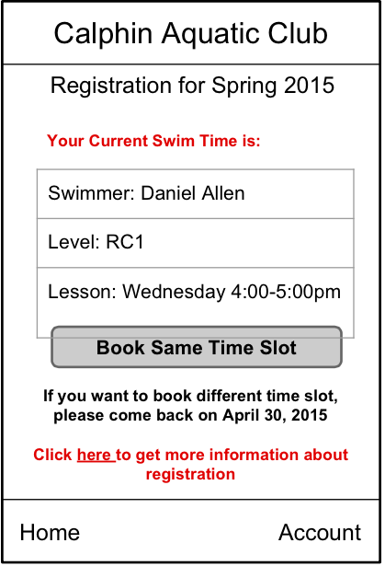
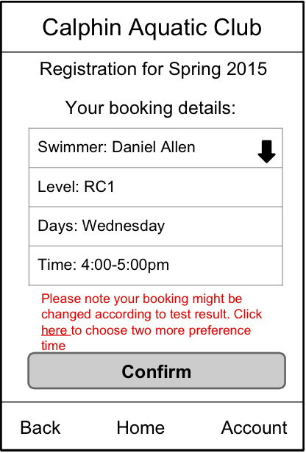
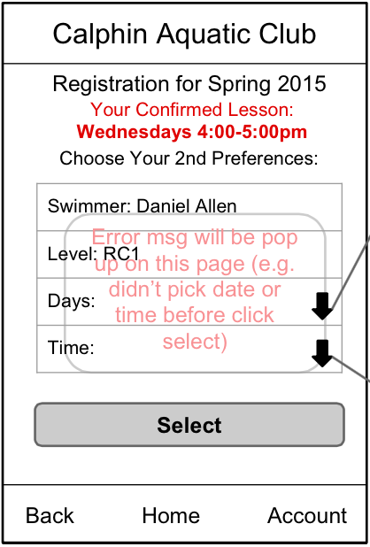
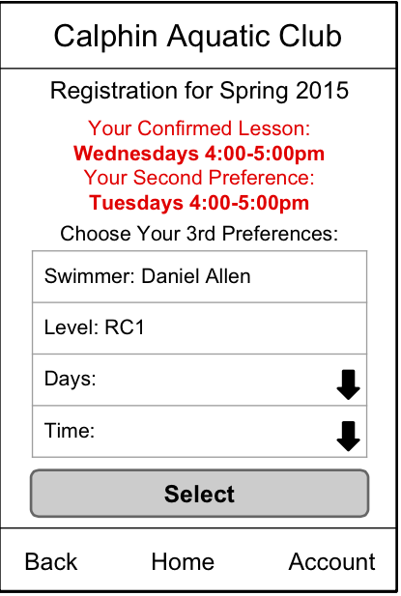

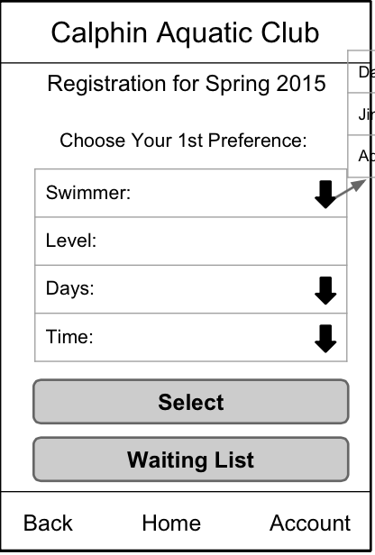
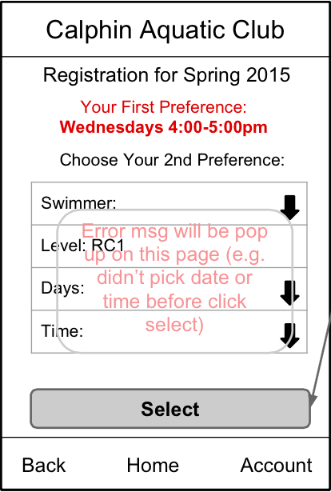
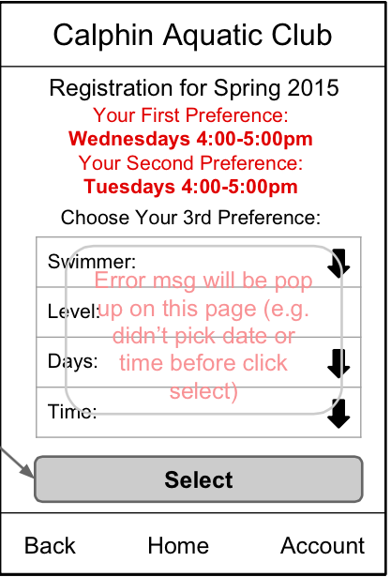
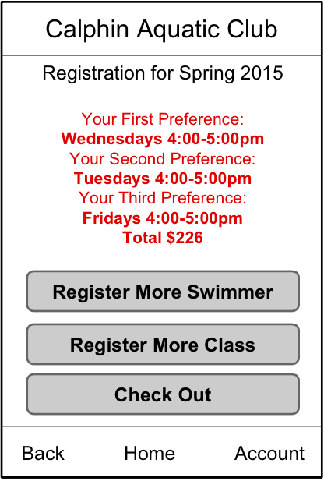

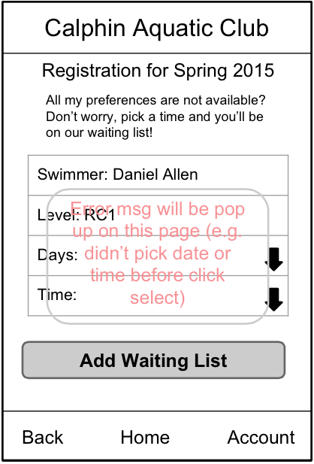

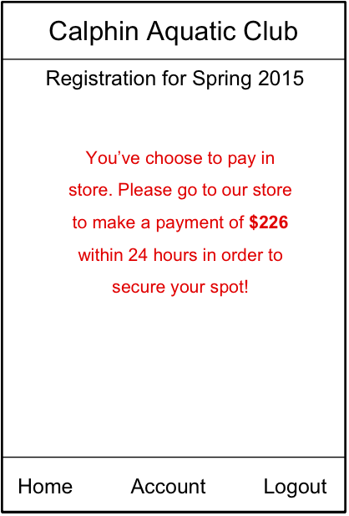
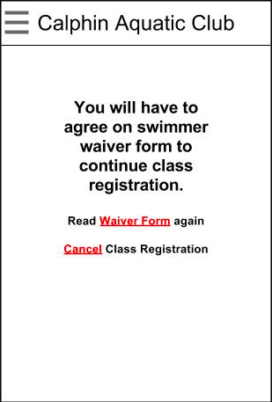


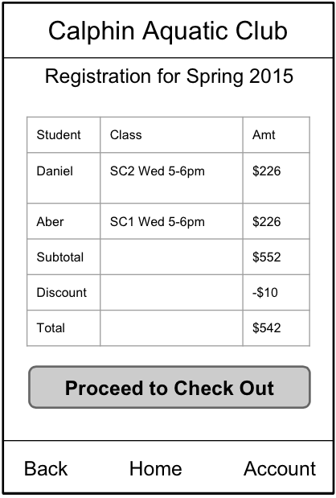
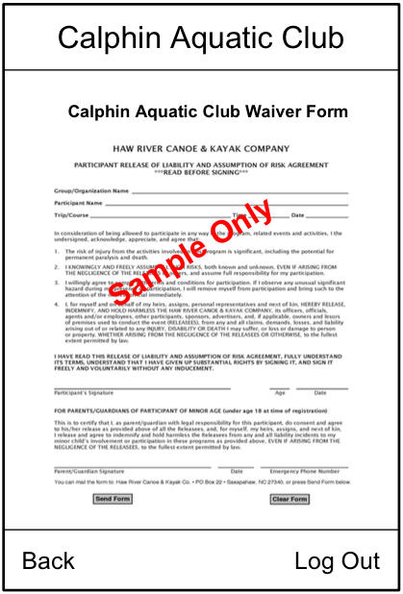
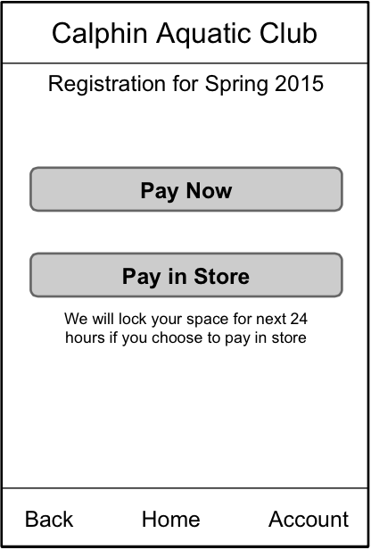



0,3
2.0
2.0a
2.01
2.01b
2.01b1
2.01b2
Reg-firstpriorityconfirm_studentID
Reg-preference2_studentiD
Reg-preference3_studentID
Reg-confirm_studentID
Reg-firstpriority_studientID
registrationhome
registrationinfo
1
a
b
1
a
2
2.2
2.1
2.11
2.111
2.1111
2.01a
Reg-preference1_stuentID
Reg-preference2_studentID
Reg-preference3_studentID
Reg-confirm_studentID
Reg-confirm_stuentdID
2
1
1
1
2.2
1
2.12
2.121
2.21b
2.31
2.32
Waitlist_studentID_classID
Waitlistconfirm_studentID
storepaymentconfirm
agreewaiver
ereceiptconfirm
escheduleconfirm
1
2.2
2.33
2.21
payment
2.3
2.0
a
b
1
Reg-billing_accountID
2
waiverform
paymentoptions
paymentconfirm
Class Registration
logout

